Slide 1
Elementary TCP Sockets

Slide 2
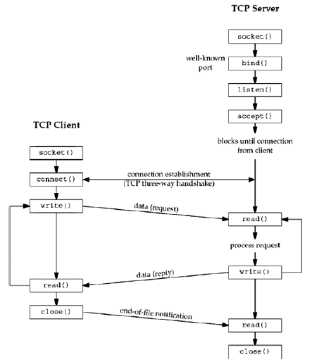
Socket functions for elementary TCP client/server

Slide 3
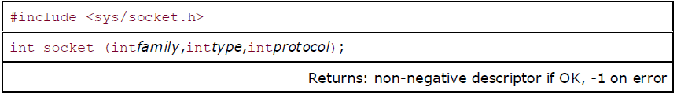
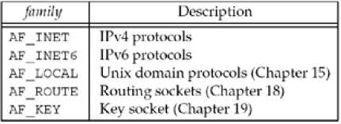
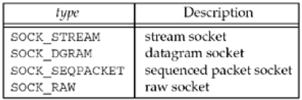
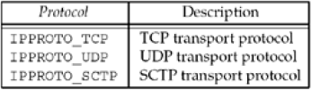
socket Function
family specifies the protocol family and is one of the constants shown in Figure
The socket type is one of the constants shown in Figure
The protocol argument to the socket function should be set to the specific protocol type found in Figure, or 0 to select the system's default for the given combination of family and type

Slide 4
AF_xxx Versus PF_xxx
The "AF_" prefix stands for "address family"
The "PF_" prefix stands for "protocol family“
Historically, the intent was that a single protocol family might support multiple address families
The PF_ value was used to create the socket
The AF_ value was used in socket address structures
But in actuality, a protocol family supporting multiple address families has never been supported
The <sys/socket.h> header defines the PF_ value for a given protocol to be equal to the AF_ value for that protocol
While there is no guarantee that this equality between the two will always be true

Slide 5
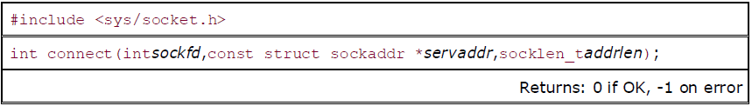
connect Function
The connect function is used by a TCP client to establish a connection with a TCP server
sockfd is a socket descriptor returned by the socket function
The second and third arguments are a pointer to a socket address structure and its size
The socket address structure must contain the IP address and port number of the server

Slide 6
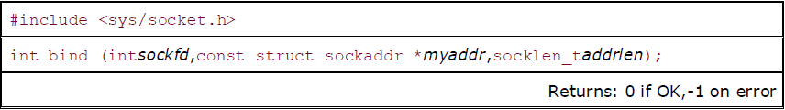
bind Function
The bind function assigns a local protocol address to a socket (sockfd)
With the Internet protocols, the protocol address is the combination of either a 32-bit IPv4 address or a 128-bit IPv6 address, along with a 16-bit TCP or UDP port number
The second argument is a pointer to a protocol-specific address
The third argument is the size of this address structure

Slide 7
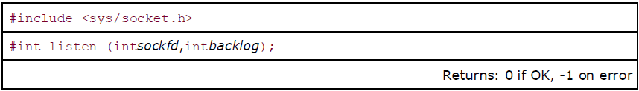
listen Function
The listen function is called only by a TCP server and it performs two actions:
When a socket is created by the socket function, it is assumed to be an active socket, that is, a client socket that will issue a connect
The listen function converts an unconnected socket into a passive socket, indicating that the kernel should accept incoming connection requests directed to this socket
The second argument to this function specifies the maximum number of connections the kernel should queue for this socket

Slide 8
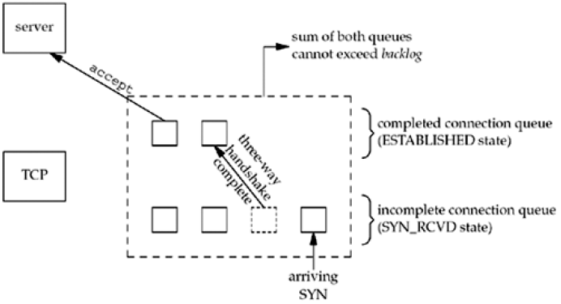
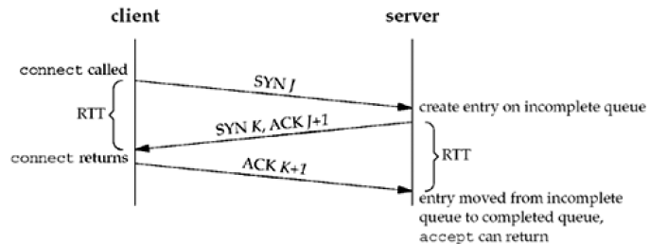
The two queues maintained by TCP for a listening socket

Slide 9
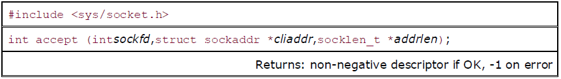
accept Function
accept is called by a TCP server to return the next completed connection from the front of the completed connection queue
If the completed connection queue is empty, the process is put to sleep (assuming the default of a blocking socket)
The cliaddr and addrlen arguments are used to return the protocol address of the connected peer process (the client)
addrlen is referred by the integer value to the size of the socket address structure pointed to by cliaddr
If accept is successful, its return value is a brand-new descriptor automatically created by the kernel that refers to the TCP connection with the client

Slide 10
Daytime server that prints client IP address and port
See Code from: intro/daytimetcpsrv1.c
solaris % daytimetcpcli 127.0.0.1
Thu Sep 11 12:44:00 2003
solaris % daytimetcpcli 192.168.1.20
Thu Sep 11 12:44:09 2003
We first specify the server's IP address as the loopback address (127.0.0.1) then as its own IP address (192.168.1.20)
Here is the corresponding server output:
solaris # daytimetcpsrv1
connection from 127.0.0.1, port 43388
connection from 192.168.1.20, port 43389

Slide 11
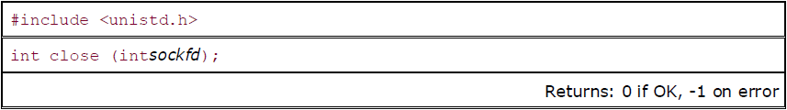
close Function
The normal Unix close function is also used to close a socket and terminate a TCP connection

Slide 12
Thank you

